Slide 1
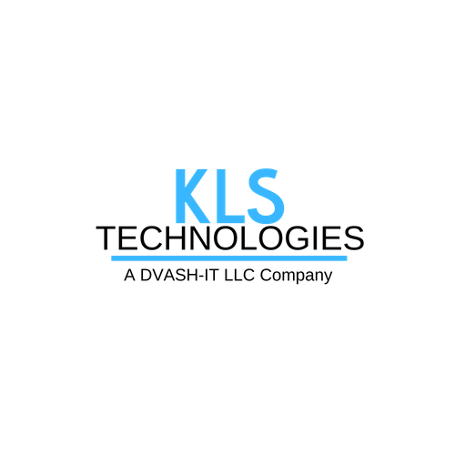
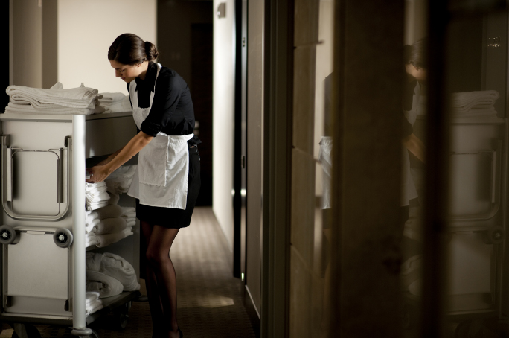
Enhancing Staff Safety with Location Awareness
(516) 829-3687 | sebastian@kls-tech.com
Hospitality

Slide 2

About AiRISTA Flow
was established in 2000 and created AiRISTA Flow formed in 2016.
10 patents for Wi-Fi-based RTLS algorithms.
Three US offices, one international office in Finland.
1,400+ systems and 10,000+ users worldwide serving, primarily:
  Federal government organizations & institutions
  Hospitals, public and private
  Hotels
  Schools
  Manufacturers
Notes:
How? Ekahau offers innovative products and patented technologies.
Founded in 2000 in Helsinki, Finland
HQ – Reston, VA
Wifi-based RTLS
Some of our hospital clients include

Slide 3
The impacts of staff safety
Helping save lives with
  Alerting functionality and automation in real-time
  Increased visibility
  Reduced response times
Increasing employee satisfaction by
  Offering peace-of-mind
  Plus, retention lowers overhead costs
Workplace safety impacts reputation
  Reduced turnover improves quality of service
  Recognition of commitment to employees within the local + greater community
Guest satisfaction
Notes:
In the most drastic sense, the topic of staff safety has to do with saving lives. Hospitals, while they’re meant to be places where people GET BETTER, can actually be very dangerous places, particularly for those who work there. There are dangerous chemicals, machinery, equipment, people and otherwise complicated situations in hospitals. Some are predictable, some are not.
According to one study, nine out of 10 emergency department managers said that patient violence is the number one threat faced by caregivers.
More than a decade ago, the rise in the mere threat of violence became so great the term “staff duress” was coined in order to characterize the phenomenon.(I’ll be using this term throughout the presentation.)
Risk profiles directly impact funding opportunities as well as a facility or organization’s overall reputation. To uphold the best Caregiver health image, you have to protect your staff and in some cases (such as in California) you’re required to take specific measures to ensure staff safety by law.
Caregiver satisfaction means more than just smiling faces and great bed side manners. While a friendly and happy staff can increase patient satisfaction, there are potentially greater rewards. Examples…
Safe workers are often healthier and happier workers. They’re able to make better decisions that affect the overall quality of care supplied to patients.
Not having to worry as much about threats can improve the overall wellbeing of workers. Which in turn impacts retention rates. Yes, happy staff means they’ll stay longer and the organization doesn’t need to invest in hiring new workers nearly as often!
Again, the direct result (that may be overlooked at times) but is CRUCIAL for senior staff to recognize: Safer, healthier, happier workers are in fact able to make better decisions that affect the overall quality of care supplied to patients. Patient satisfaction goes a long way to improving your reputation, funding, referrals, and repeat clientele.
So staff safety plays a really big role in your overall operations.
8 Seidman, William and Rick Grbavac (March 7, 2013). Creating a Culture of Patient Safety. Hospitals and Healthcare Networks. Available at: http://www.hhnmag.com/hhnmag/HHNDaily/HHNDailyDisplay.dhtml?id=3110007162
9 Collings, Russell and Tony York (October 2009). Hospital and Healthcare Security. Burlington: Butterworth-Heinemann.

Slide 4
Exploring solutions for specific situations
Around the clock panic/duress alerting for
  Housekeeping
  Service workers
  Kitchen staff
  Front of the house: reception, valet, bellhop, spa, shops
Hand Hygiene compliance in kitchens/casinos
Asset Tracking of equipment (e.g. carts, fixtures, tools)
Workflow for service calls, clean/dirty room status, or par level alerts
Temperature Monitoring
Notes:
We’re here to talk mostly on Location awareness but there are other aspects to consider to improve staff safety that can’t be ignored too.
First and foremost, the design of a hospital must regard safety considerations- for staff and for patients. For example: radiation equipment rooms aren’t generally placed near the NICU, and the emergency room isn’t usually located right next door to the visitors entrance. Smaller scale design also matters: waiting areas, triage, administration, drug storage- all of these areas should be strategically designed to minimize threats to staff and patients.
Disaster preparedness: from evacuation plans, and process checks to data backups, there are plenty of small steps that can be taken to help in the instance of disaster- natural or otherwise.
Paging systems are a huge help in hospitas. Localized and mass alert capabilities are vital to keeping staff informed of all work matters including those related to their safety.
Video monitoring …this can be quite helpful in not only assessing dangers but deterring them.
Security Guards- same thing. Great resource for onsite safety and security both as a reactive and preventive asset.
And last, Real Time Location Systems. These can be used to enhance staff safety in many many ways.
First, they can be used to set alarms. Alarms set off by proximity breaches AND by utilizing manual triggers.
RTLS can monitor temperatures. Some chemicals or refrigeration units pose dangers when certain humidities or temperatures are not maintained and RTLS can be used to detect and inform authorities of potential dangers.
Duress messaging- RTLS is a great solution for silent alarming. It can be used to set of 1:1 alerts, 1:many notices, and even two way messaging can be enabled with this technology.

Slide 5
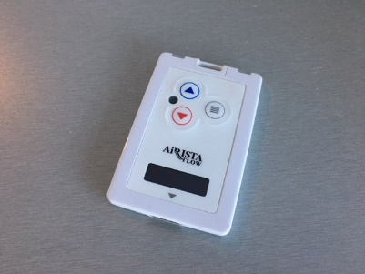
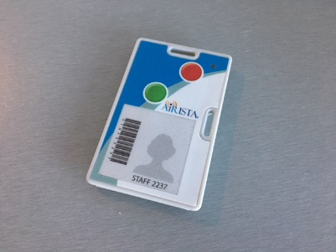
Wearable Badge Tag:
Airista Flow B4 and T5
AiRISTA FLOW B4
AiRISTA FLOW T5
Notes:
The Ekahau B4 Tag provides accurate location for tracking people within your enterprise using your existing WiFi network. The B4 Tag enables easy 2-way communication amongst staff members. The B4 recognize condition-aware business rules/workflow and provide appropriate context-aware display proactively enforcing workflow specific towards staff efficiency and increasing productivity.
LED Display
2 configurable buttons & Menu access button
Safety switch configurable
Variety of audible alerts

Slide 6
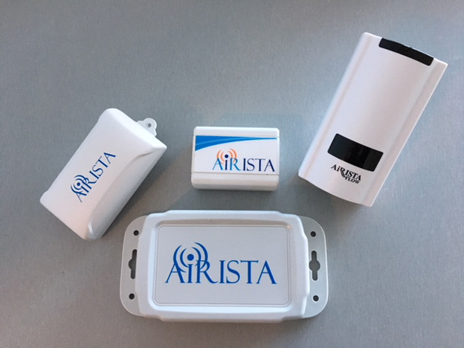
Infrastructure
Wall Pluggable
BLE and WiFi
Beacon/Locator
Battery Powered
BLE
Beacon/Locator
Battery Powered
Infrared / IR
Beacon/Locator
PoE Powered
BLE to Ethernet
Gateway / PSU

Slide 7
Location awareness– alerts and messaging
Lower response times. Decrease the likelihood of injury or death.
  panic button/silent alarms is associated with lower rates of physical violence.
Provide location information to specified authorities.
Provide information to various system types, anytime, anywhere.
  Emails.
  Mobile phones.
  Integrated systems.
Send mass communications.
Enable receipt confirmation.
Indicate man-down instances based on timed motion detection.
Notes:
Before we jump into the Ekahu solution, let’s quickly cover some specifics about benefits – and just how location information can be used to enhance staff safety:
First: Knowing the exact time and location of an emergency can reduce response times and with it, the likelihood of injury or death----- and ultimately: can create a safer environment for staff.
- In fact, the use of a panic button/silent alarms has a proven association with lower rates of physical violence.
Many silent alarm systems and voice dialing systems lack location visibility and rely on the caller to give their location, which is not feasible in many real-life instances in hospitals. Real-Time Location Systems can offer emergency location visibility along with proximity-based text alerts and be sent to emails and mobile phones so that the staff members close by are those who are called on to help.
Some solutions, such as Ekahau’s, even offer receipt acknowledgement, mass communications and man-down alerts based on timed-motion detection that is built into the RTLS tags and badges.
With location–aware alerting, caregivers, visitors and other staff have peace of mind because they know help is nearby.
Talk about real-world scenarios
“If you downloaded the handout, there is an extra slide with a few links to case studies and videos from some of our customers. I strongly urge you to check those out whenever you a few minutes. There are some really neat examples of how hospitals are using and relying on Ekahau right now.”

Slide 8
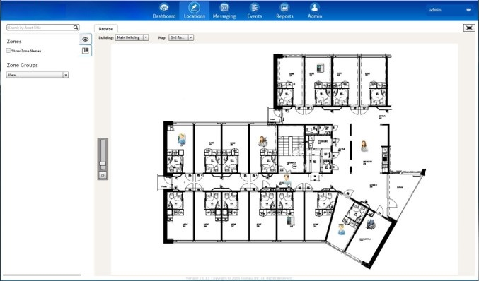
Locations in RTLS Software
Notes:
Ekahau Vision software gives managers and end users visibility into the location, condition and status - of assets, people and workflows across departments and throughout the facility/system. Vision uses actual floor plans and visual icons to display the building, floor, zone, room and sub-room locations and each end user can customize the Vision interface to provide views specific to their duties.
Vision is designed to improve operational decision-making with location and event-based alerting that enables work-flow automation.

Slide 9
Union and City Mandates
Recently, local safety ordinances including:
Section 4-6-180 of the Chicago Municipal Code,
Seattle Initiative 124,
New York Hotel and Motel Trades Council, AFL-CIO contract section 70 and
Washington DC – Local 25.
mandated panic buttons for hotel workers.
MORE TO COME:
The union representing 14000 hotel workers in Las Vegas is now asking hotels to give every housekeeper a "panic button” to help prevent assaults on hotel staff, a spokeswoman for Culinary Workers Union Local 226.
California may require hotels to equip housekeepers with panic buttons
Piggybacking on the #MeToo movement, support is gaining momentum nationwide to protect hotel housekeepers from sexual harassment by guests, by requiring hotels to provide them with panic buttons.
In California, just such a bill (Assembly Bill 1761) was introduced on Jan. 4.
Miami - http://www.miamiherald.com/news/business/article189442764.html

Slide 10
Certified Partner
KLS TECHNOLOGIES
239 Great Neck Road, Suite 201
Great Neck, NY 11021
sebastian@kls-tech.com
516-829-3687
Notes:
Ekahau Vision software gives managers and end users visibility into the location, condition and status of assets, people and workflows across departments. Vision uses actual floor plans and visual icons to display the building, floor, zone, room and sub-room locations and each end user can customize the Vision interface to provide views specific to their duties.
Vision is designed to improve operational decision-making with location and event-based alerting that enables work-flow automation.

